Slide 1
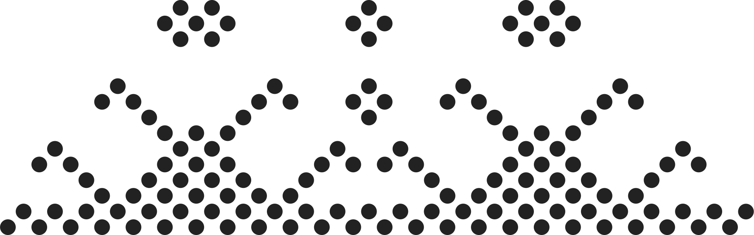
AdaDelta & Adam
Optimizer Algorithm
presented by
Nguyen Quoc Hung - 2470889

Slide 2
Pre-requisites
Introduction to Problem
AdaGrad – Dynamic Learning Rate
Introduction to EMA
Main Problems for Optimization Algorithm
The purpose of AdaDelta and ADAM
AdaDelta
Adam
Introduction
Mathematic Formula
Limitation
Introduction
Mathematic Formula
Limitation
Conclusion
Outline

Slide 3

Core Problem
Challenges with normal gradient algorithms such as Gradient Descent, Stochastic Gradient Descent,..:
Difficult Navigation: Local minima and saddle points can trap the optimizer, leading to suboptimal solutions.
Gradient Scaling Issues: Vanishing or exploding gradients in deep networks.
Inflexible Learning Rate: A single, fixed learning rate is inefficient and hard to tune.
The adaptive methods like AdaDelta & ADAM can help us

Slide 4
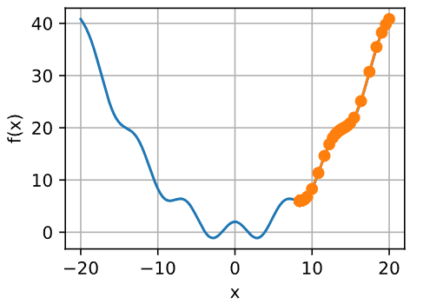
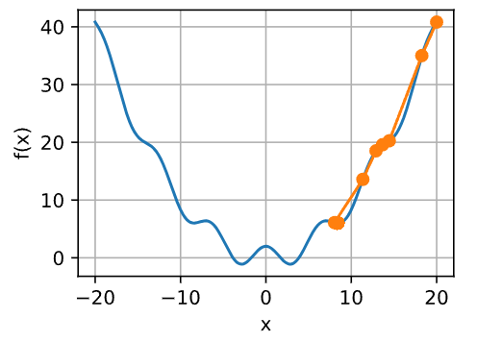
Core Problem
Learning rate = 0.2
Learning rate = 0.8

Slide 5
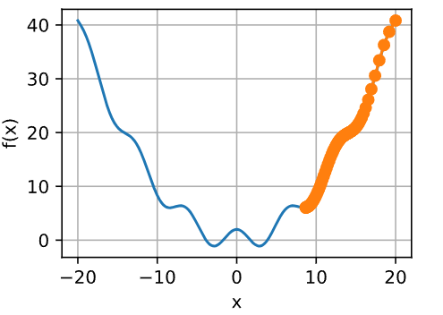


Pre-requisites: AdaGrad
AdaGrad is an optimization algorithm that is designed to adapt the learning rate for each parameter. It is beneficial for sparse features
Accumulator calculation
Final parameter

Slide 6


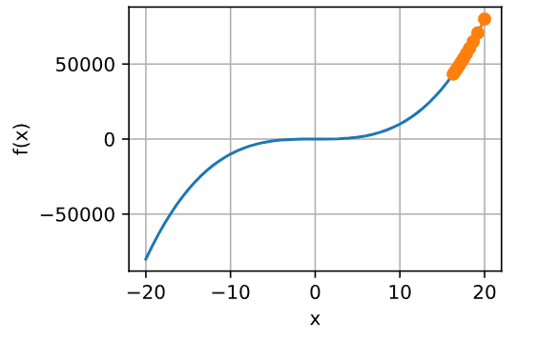
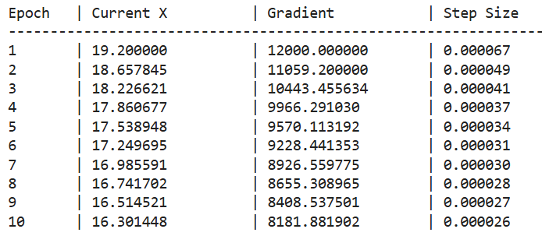
AdaGrad Limitation

Slide 7

Exponential Moving Average (EMA)
EMA stands for Exponential Moving Average
It is a statistical method used to create a smoothed average of a sequence of data
EMA is used to stabilize training by placing more weight on the most recent data points, with the influence of older points decreasing exponentially over time
The EMA can be expressed within this formula

Slide 8
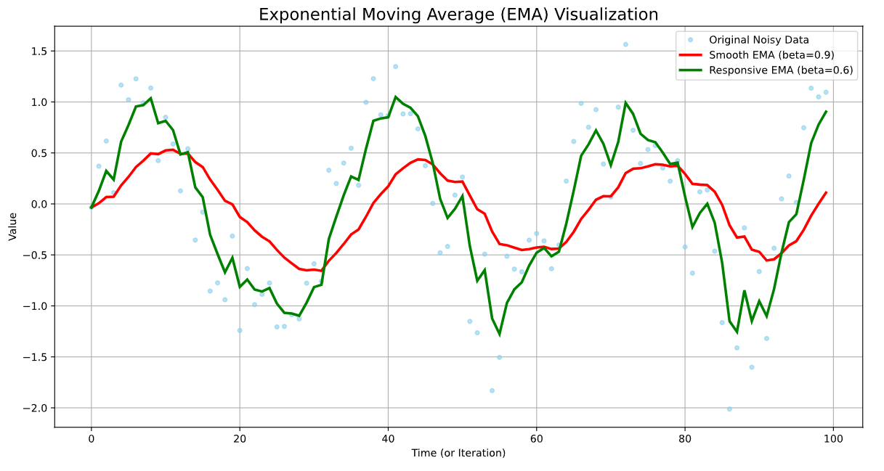
Exponential Moving Average (EMA)

Slide 9



AdaDelta
AdaDelta addresses AdaGrad’s decaying learning rate by using an Exponential Moving Average (EMA) of gradients
It uses 2 EMAs parameters:
Average of Past Squared Gradient
Average of Past Squared Updates
Where:

Slide 10
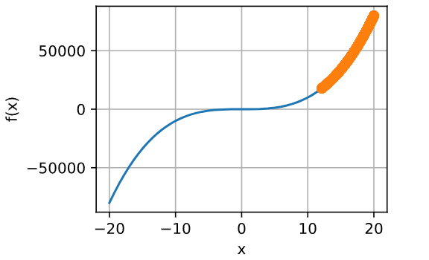
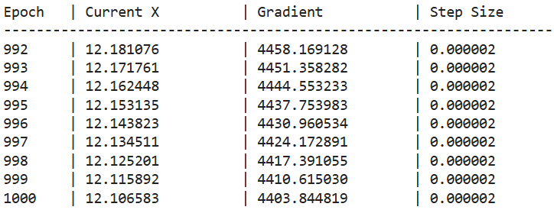
AdaDelta - Limitation

Slide 11


Adam
ADAM algorithm is a comprehensive optimization method that combine several effective techniques into one.
It use mini-batching for efficient processing
Momentum to accelerate convergence by using the past gradients
per-parameter scaling to adjust the learning rate for each parameter
It uses 2 EMAs parameters as well:
Track the variance of the gradients
Tracks direction of the updates

Slide 12



Adam - Bias Correction
Since the initial bias of its moving average estimates toward zero, which can be small during the first few steps of training
=> Bias correction is used to scale them up, which ensures the step sizes are appropriately large and estimate are more accurate from the beginning
Bias correction of s_t & v_t
Rescaled gradients

Slide 13
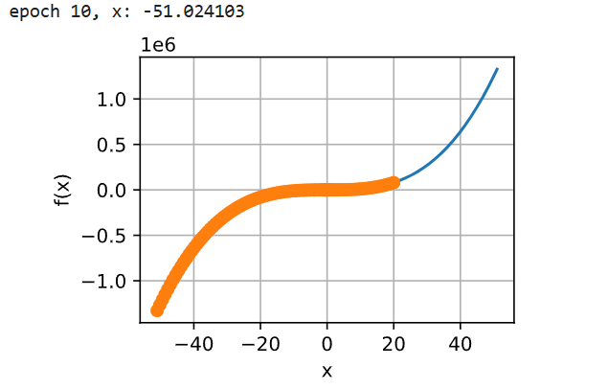
Adam - Experiment

Slide 14

Adam - Yogi Improvement
Within the second moment
5
As the g_t becomes very large, noisy, and infrequent, this can lead to the learning rate being minimal => Consequently, Adam will lose its memory of the historical gradient magnitudes, and the model can not converge properly
Yogi improvement

Slide 15
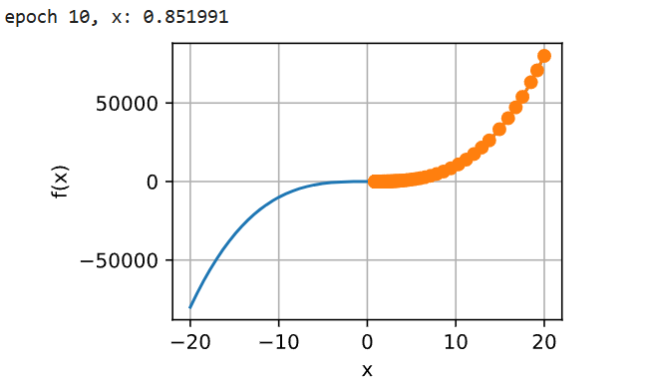
Adam - Yogi Improvement

Slide 16
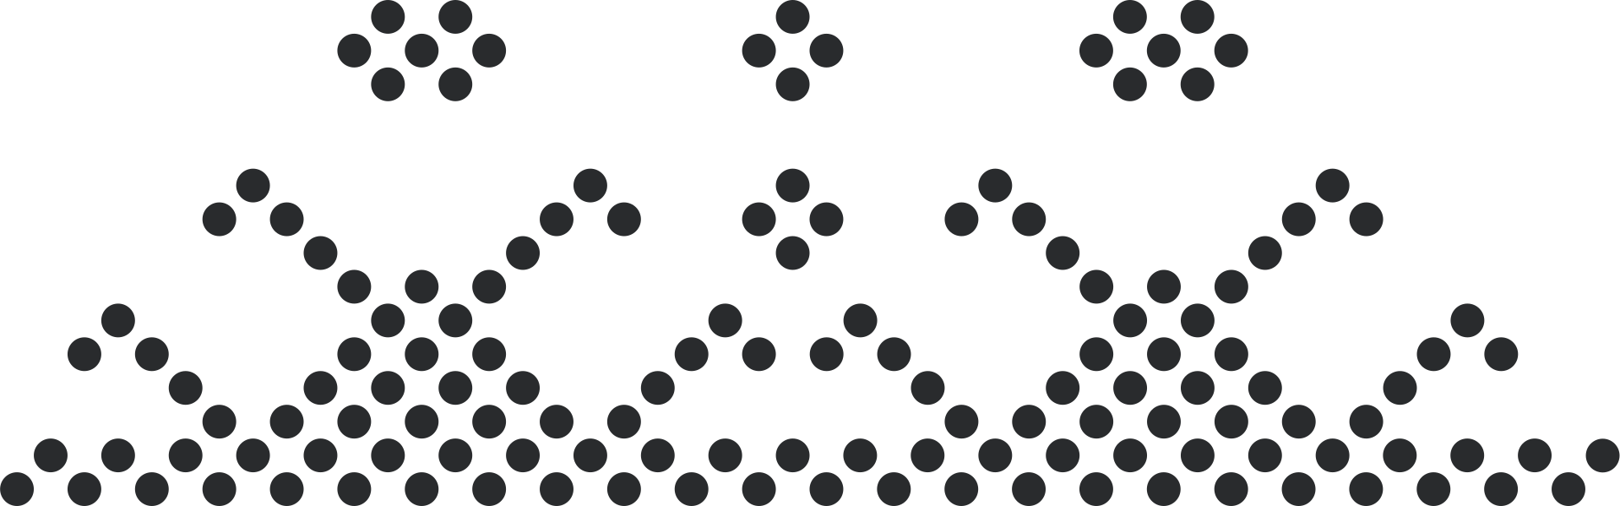
Conclusion
Key Takeaway
ADAM: Fast & Reliable
Combines momentum with adaptive learning rates and includes bias correction
Recommended default optimizer for most deep learning applications due to its speed and reliability
ADADelta: Simple & Tuneless
Simplifies training with adaptive learning rate
A good choice when easy setup is essential, but convergence can be slower

Slide 17
Thank You
for
Listening !!!

